Slide 1
Optimization of Electromagnetic Driven Origami
Unit Actuator
R12522630高仕懷¹ R12522620蘇 瑄¹ R12522627謝定群¹
Notes:
Our group project is to optimize an Electromagnetic Driven Origami Unit Actuator.

Slide 2
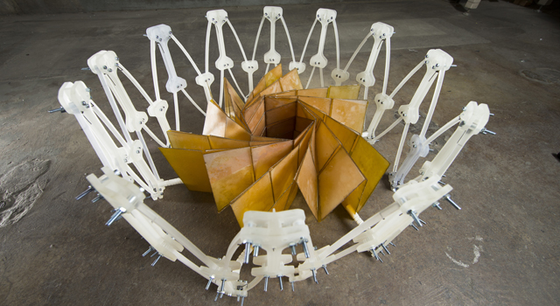
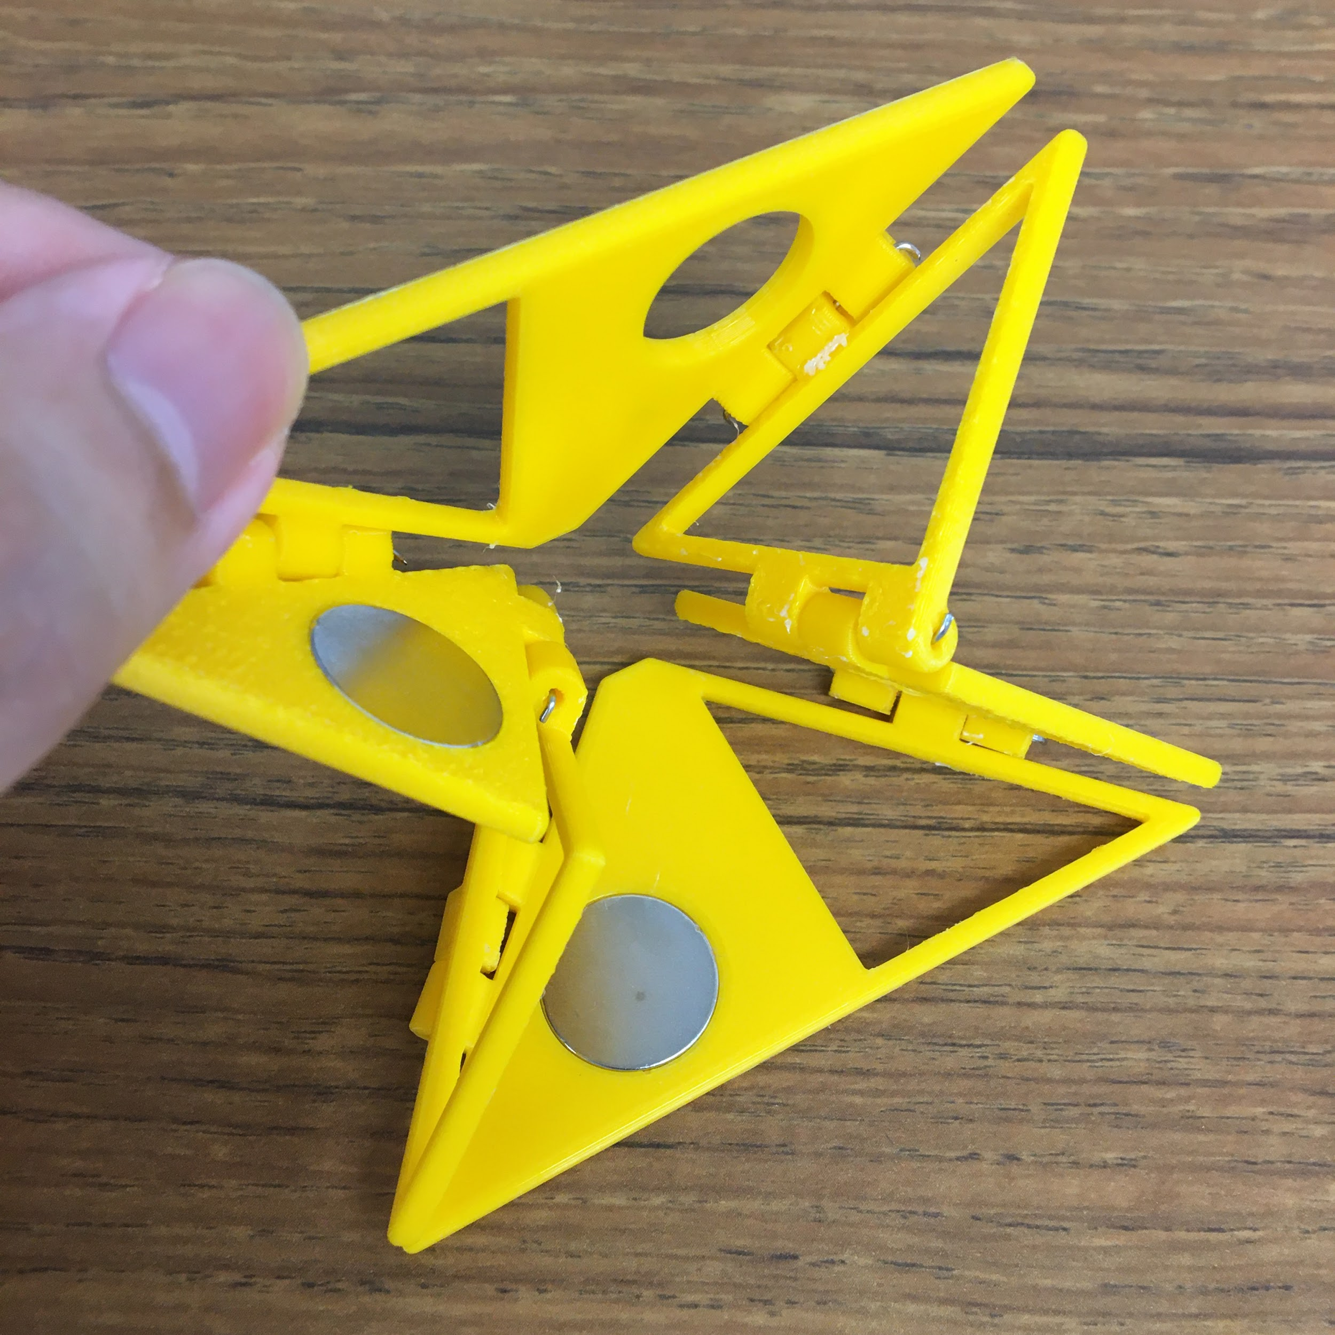

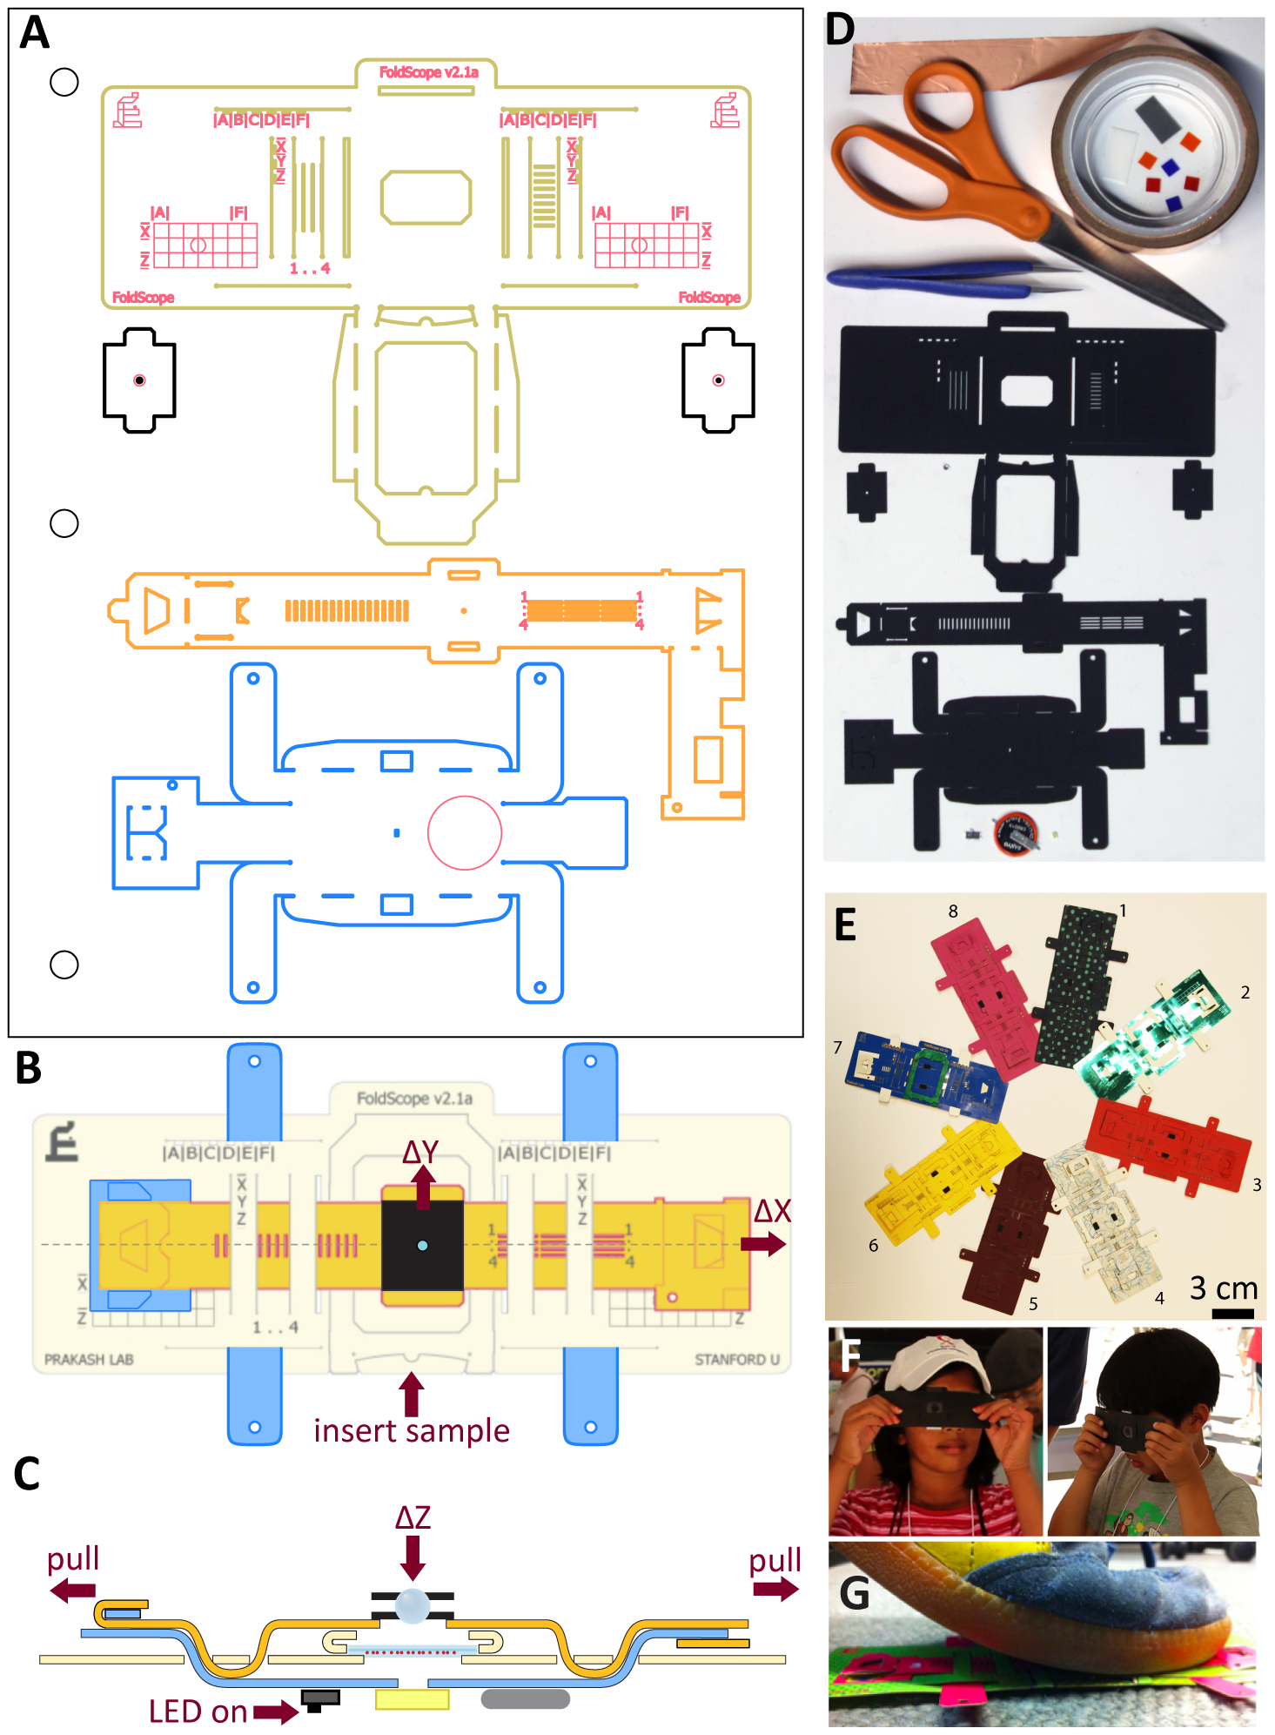
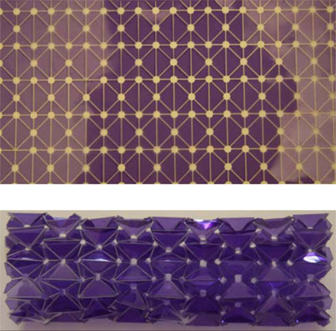
Background
Solar Technology[1]
Medical Devices[2]
The Designed Actuator Prototype
Worm Robot[3]
Notes:
Origami techniques have found diverse applications across various industries,
solar technology[1]（solar power generation）, and medical devices(圖片裏是顯微鏡）[2][3].
The inherent attributes of origami, such as make it a particularly promising avenue for exploration within the field of robotics.
Driven by electromagnetic presents an opportunity to simplize mechanical designs and economize on space utilization. This approach allows us to harness the full potential of origami principles in developing innovative robotic solutions, improving both space efficiency.
This is the actuator, when we place coils in this triangle and apply voltages, it will create a magnetic field that pushes the frame up, resulting in the rotation of the unit.
This robot will exhibit capabilities such as crawling and rotation like worm robots(Onal, Wood, and Rus, 2013)[5]. Our focus is on optimizing the magnetic force of the coils within the constraints of limited space and power, thus enhancing overall performance.

Slide 3
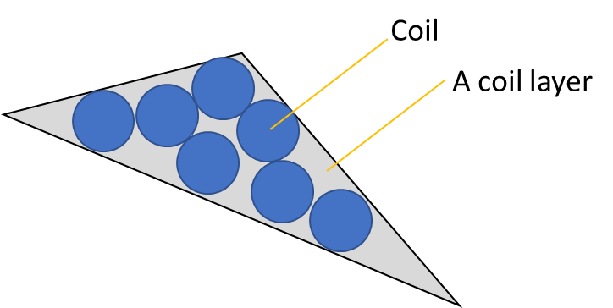
Design variables & Design parameters
Design variables
Number of each coil’s turns (N)
Total number of coils (Nt)
Diameter of Coil Wire (D) in m.
Input Current (I) in A.
Design parameters
Material of coils (M)
Notes:
Here are our design variables.
The number of each coils’ turns is considered because it’ll affect the Magnetic Field Distribution and the inductance. (Each turn of the coil creates a magnetic field, so the more turns you wind, the greater the magnetic field will be. The inductance is proportional to the square of the number of turns. A higher inductance can stabilize current and voltage in the circuit, preventing rapid changes in current)
the second one is Nt, which represents the total number of coils, it is the number of coils that can be placed into the triangular frame, so it’ll also affect the strength of the magnetic field.
the third one is the diameter of the coil, it will affect the number of layers we can put into the frame , which also affects the strength of the magnetic field, (As the diameter of the coil increases, the same current will be dispersed over a larger cross-sectional area, which may lead to a decrease in current density, then weakening the strength of the magnetic field)
the last variable is The current ,it needs to be considered as well because the magnetic field will change as the current changes.
and our design parameter is The material of the frame .Currently, we are using copper wire.

Slide 4
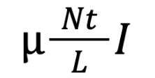
Objective function
min f(Nc, NL, D, I, M)= -B= -
= magnetic constant, = 4pi x 10^-7 (H/m)
Nt = Total number of coils ,Nt=NC X NL
L = coil total thickness (=T0 frame thickness) in m
I = Input Current in A
Notes:
This is our objective function, we aim to maximize the magnetic field strength B at the same Power.
In order to actuate the mechanism, the magnet field generated by the coil needs to be strong enough. The strength(B) is determined by the total number of coils, the total thickness of the coil, and the current.
Due to the fact that electromagnetic coils are powered by electricity, different coil designs can have an impact on the magnetic field produced and power performance.
Coils with excessive power consumption can lead to unnecessary heat generation, thereby limiting the applicability of electromagnetic actuators. Therefore, this project uses the magnetic field size at the same power level as the standard for evaluating coil performance.
Designs that produce greater magnetic force at the same power consumption are better suited for the requirements of electromagnetic actuator design

Slide 5
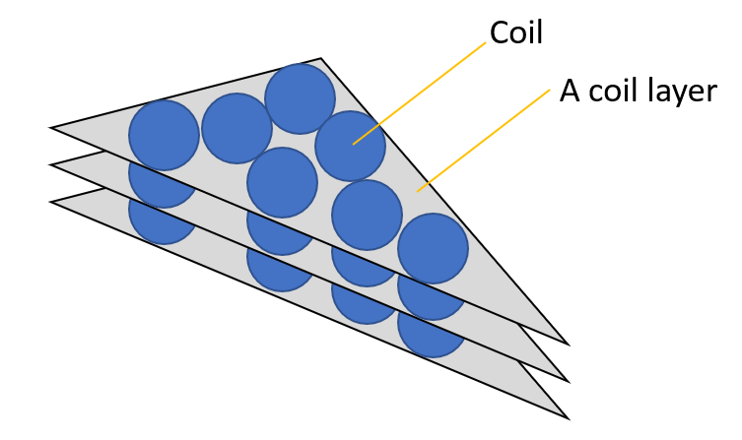
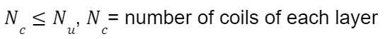
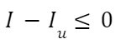
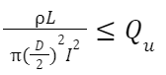
Design constraints
Number of coil layers
Number of the coils in each layer
Input current limit
Power consumption of the coils
Notes:
these are our constraints,
The number of coil layers needs to be compatible with the mechanism; if it's too thick, it will be hard to fit into the mechanism. The thickness limit restricts both the number of coil layers and the diameter of the coil wire.
Due to the power supply system and heat generation of the coil, the current is constrained not to exceed certain values Iu.
Our frame has a triangular shape rather than a circular one, and one potential design option involves altering the coil's shape. This could involve using a single large circular coil, multiple smaller circular coils, or a combination of different coil shapes. Due to the frame's geometry, each design has a maximum limit on the number of coils.
these are the coil heat generation which need to be constrained

Slide 6
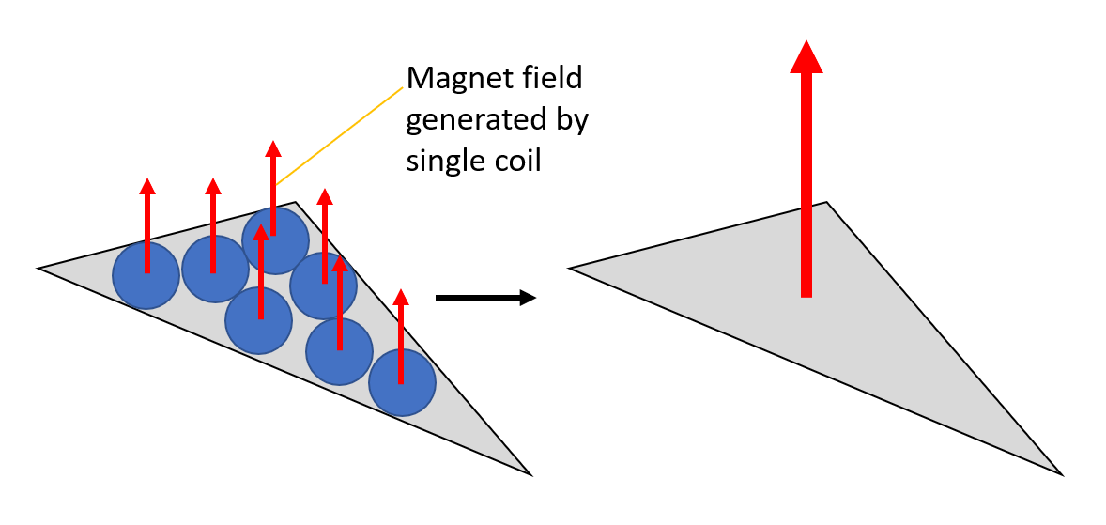
Design assumptions
The magnet field generated by different coils can sum up.
The gap inside the coil is close to zero.
The coil is in ideal condition.
The coils act like a solenoid.
Notes:
We assume that the magnetic fields generated by different coils can sum up because one of our design variables is the total number of coils. We made this assumption so that multiple coils can function as a single coil.
Our second assumption is that the gap inside the coil is close to zero because our coil is wound in different layers. We made this assumption to simplify the calculation.
The third assumption is that the coil is in an ideal condition. We assume that the behavior of the coil closely follows the theory rather than real-world conditions.
and the last one is that we Assume that the coils behave like solenoids, this would
this is the end of our presentation ,thank you

Slide 7
Reference
[1] Landau, E. (2014). Solar power, origami-style. NASA. Ed. Tony Greicius. NASA, 14.
[2] Cybulski, J. S., Clements, J., & Prakash, M. (2014). Foldscope: origami-based paper microscope. PloS one, 9(6), e98781.
[3] Onal, C. D., Wood, R. J., & Rus, D. (2012). An origami-inspired approach to worm robots. IEEE/ASME Transactions on Mechatronics, 18(2), 430-438.

Slide 8
Summary
Objective function
Design variables
Number of each coil’s turns (N)
Total number of coils (Nt)
Diameter of Coil Wire (D) in m.
Input Current (I) in A.
Design parameter
Material of coils (M)
Design constraints
Number of coil layers
Number of the coils in each layer
Input current limit
Power consumption of the coils
Assumption
The magnet field generated by different coils can sum up.
The gap inside the coil is close to zero.
The coil is in ideal condition.
The coils act like a solenoid.
min f(Nc, NL, D, I, M)= -B= -

